Slide 1
X-Informatics Introduction: What is Big Data, Data Analytics and X-Informatics? Part I
January 7 2013
Geoffrey Fox
gcf@indiana.edu
http://www.infomall.org/X-InformaticsSpring2013/index.html
Associate Dean for Research and Graduate Studies, School of Informatics and Computing
Indiana University Bloomington
2013

Slide 2
Data Deluge Internet

Slide 3
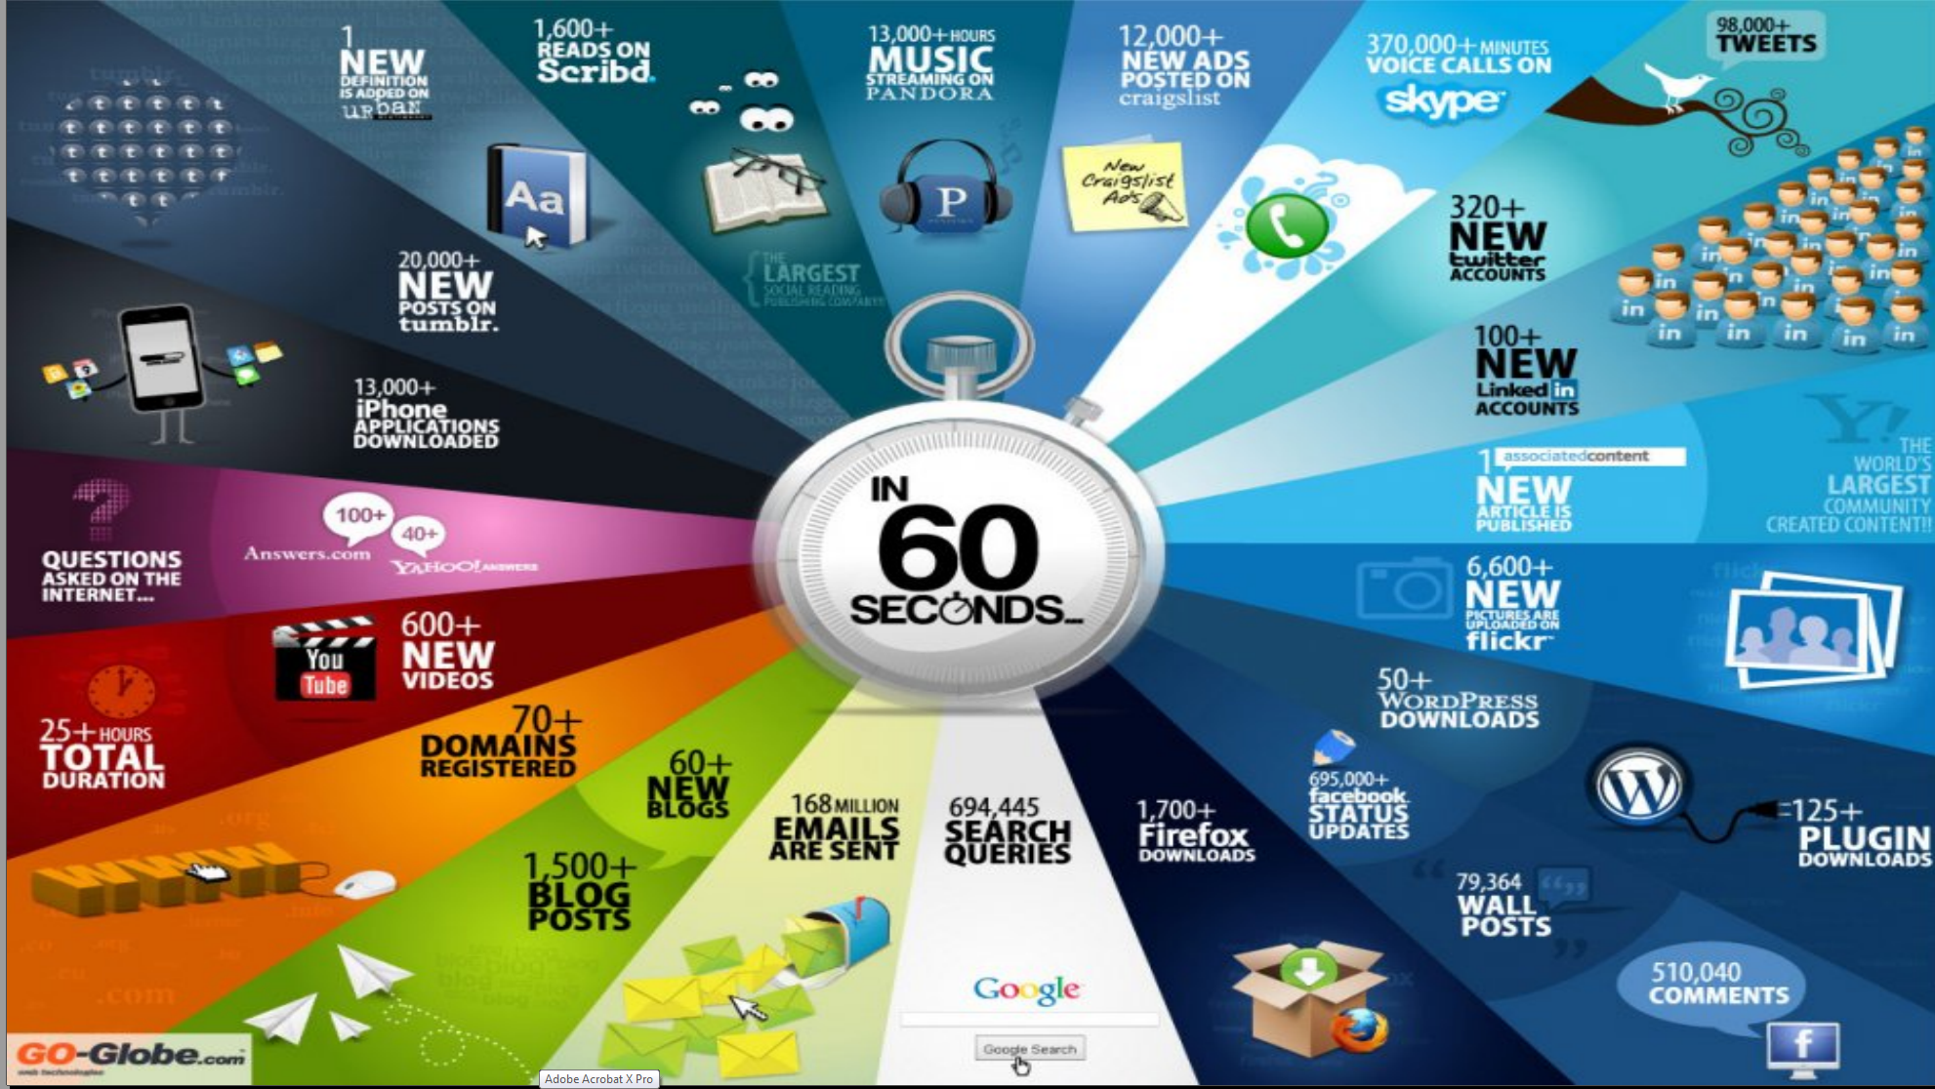
http://cs.metrostate.edu/~sbd/ Oracle

Slide 4
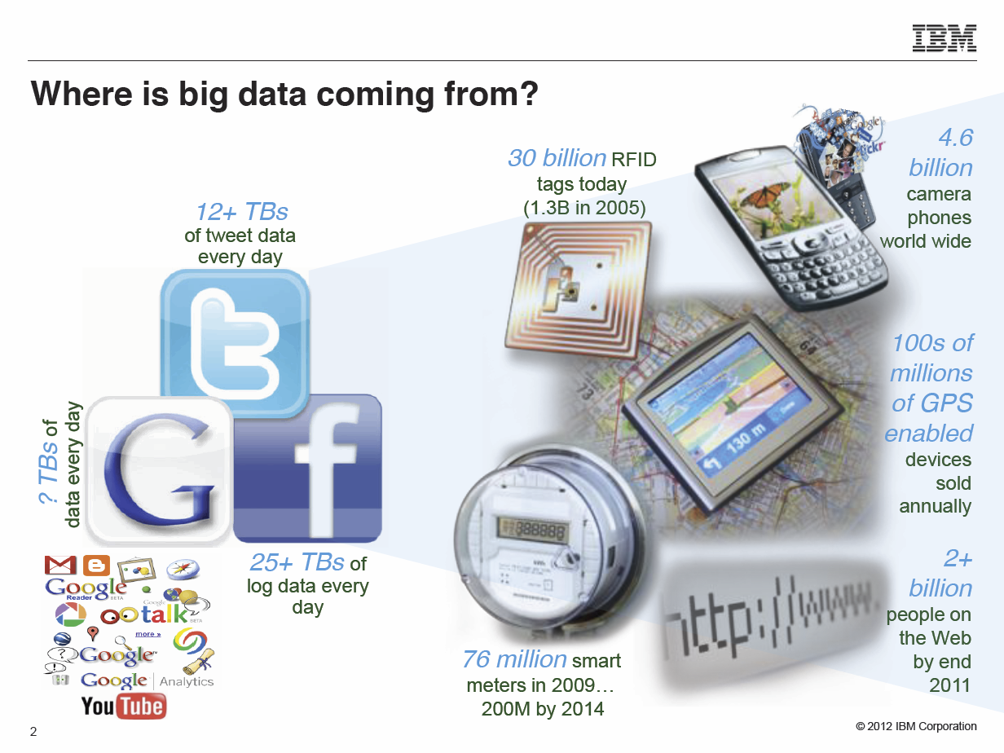
Anjul Bhambhri, VP of Big Data, IBM http://fisheritcenter.haas.berkeley.edu/Big_Data/index.html

Slide 5
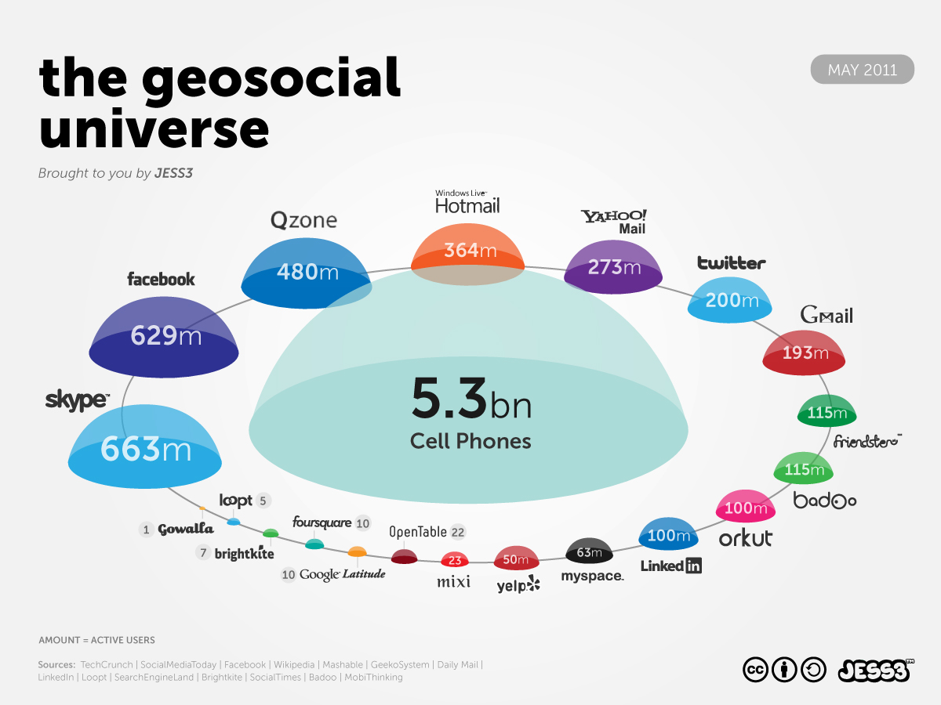
http://jess3.com/geosocial-universe-2/

Slide 6
Data Deluge Business

Slide 7
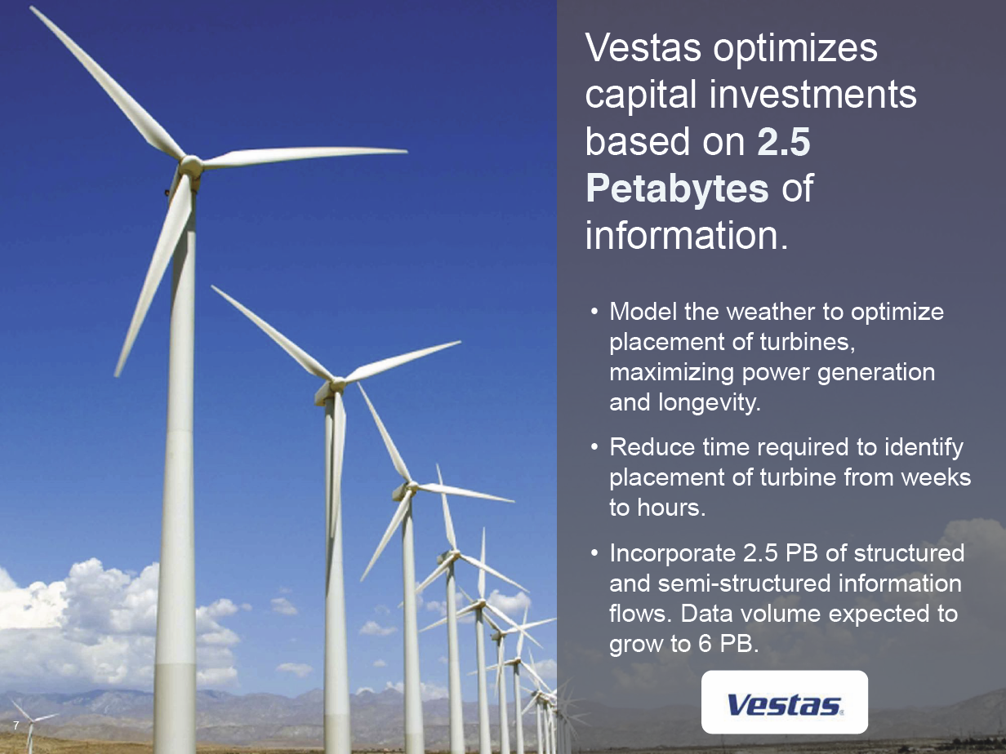
Anjul Bhambhri, VP of Big Data, IBM http://fisheritcenter.haas.berkeley.edu/Big_Data/index.html

Slide 8
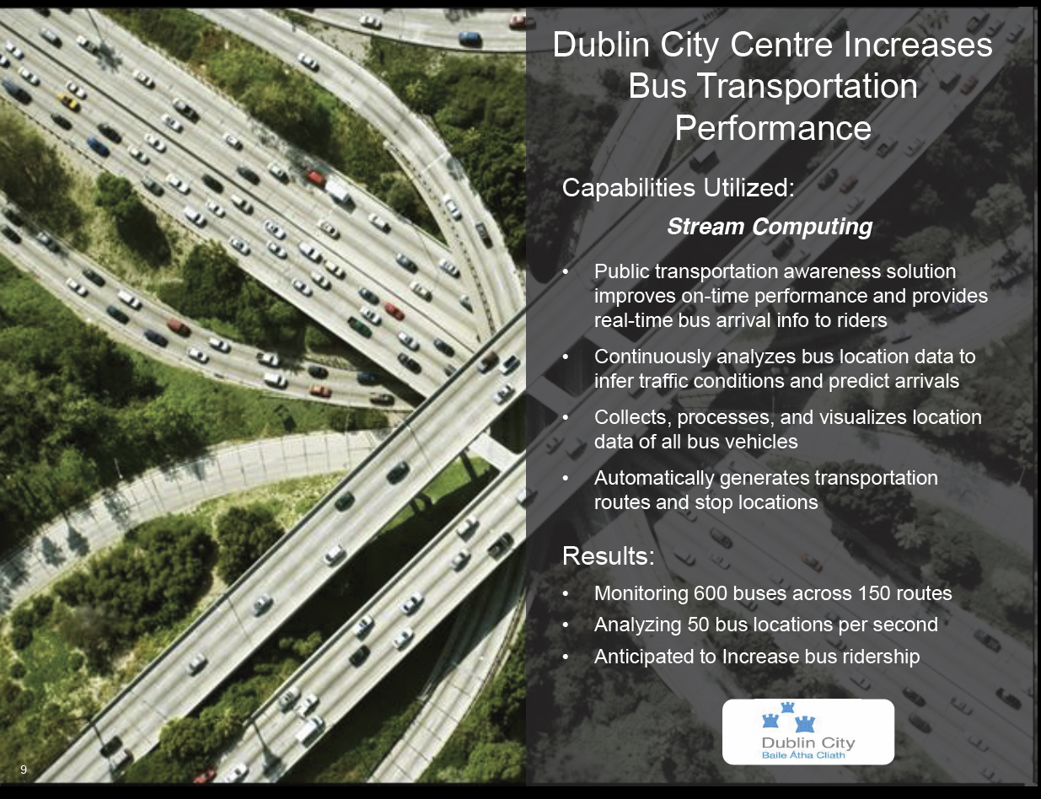
Anjul Bhambhri, VP of Big Data, IBM http://fisheritcenter.haas.berkeley.edu/Big_Data/index.html

Slide 9

CDR = Call Data Record
Anjul Bhambhri, VP of Big Data, IBM http://fisheritcenter.haas.berkeley.edu/Big_Data/index.html

Slide 10
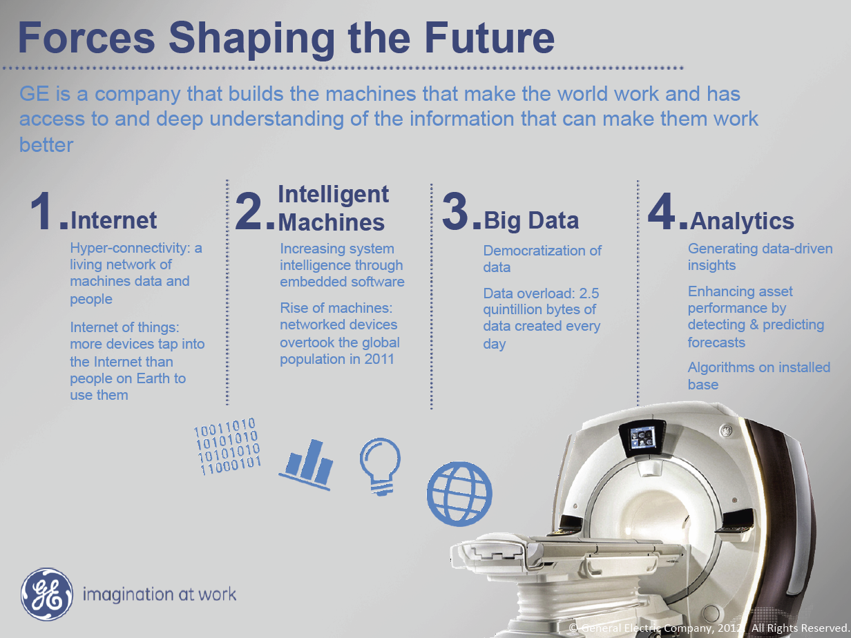
Internet of Things
Ruh VP Software GE http://fisheritcenter.haas.berkeley.edu/Big_Data/index.html

Slide 11
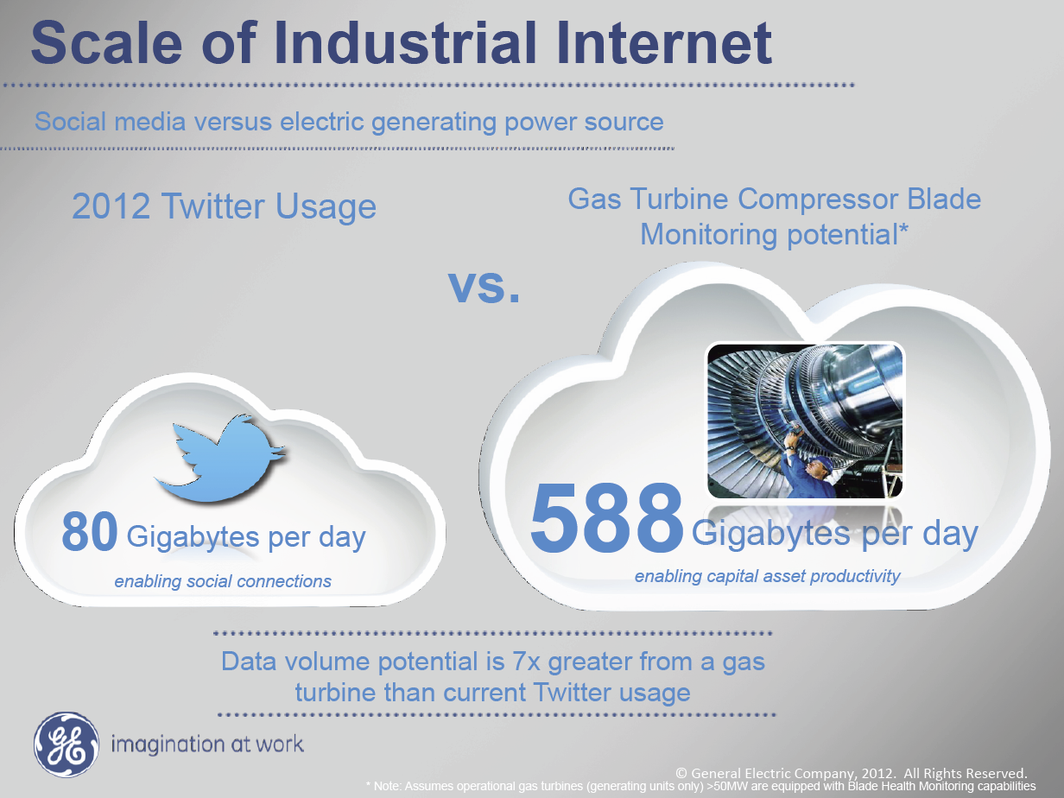
Ruh VP Software GE http://fisheritcenter.haas.berkeley.edu/Big_Data/index.html

Slide 12
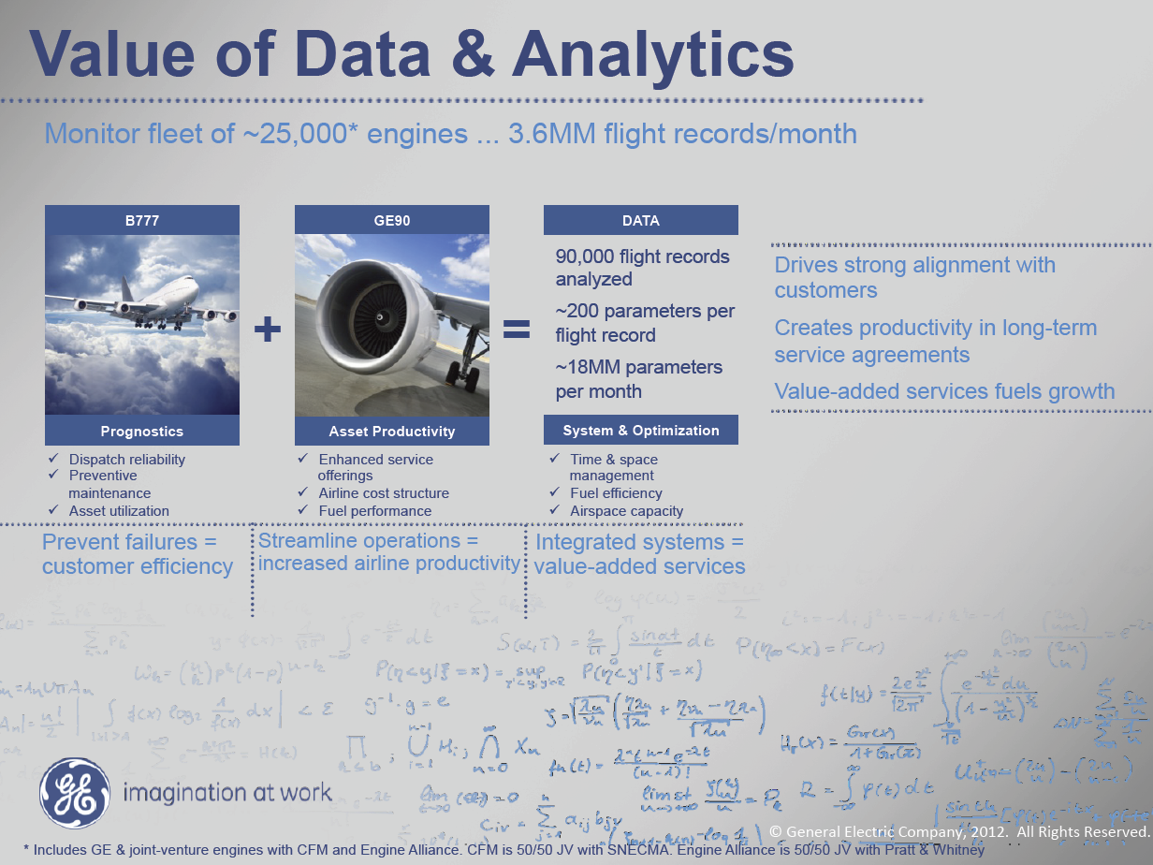
MM = Million
Ruh VP Software GE http://fisheritcenter.haas.berkeley.edu/Big_Data/index.html

